Slide 1

Lecture 1
Intro to HTML

Slide 2
Topics
Introduction
History of JavaScript
Browser Debugging Tools
The JavaScript Console
Console.log
Syntax Examples

Slide 3
World Wide Web

Slide 4

Invention of WWW
Tim Berners-Lee, a British scientist, invented the World Wide Web (WWW) in 1989, while working at CERN. The Web was originally conceived and developed to meet the demand for automated information-sharing between scientists in universities and institutes around the world.
HTML (Hyper Text Markup Language) was first developed by Tim Berners-Lee in 1990. He is the primary author of HTML with the assistance of his colleagues at CERN, an international scientific organization based in Geneva.
He invented HTML for converting any word document into a file viewable on the Internet, thus it will be available to anybody with an internet connection. It is also used to define the structure and layout of a web page.

Slide 5



What is CERN?
The European Organization for Nuclear Research, known as CERN, is a European research organization that operates the largest particle physics laboratory in the world. Established in 1954, located in Geneva on Franco-Swiss border.
Home of the Atom Smasher (Large Haron Collider)
Notes:
http://info.cern.ch/hypertext/WWW/TheProject.html
http://line-mode.cern.ch/www/hypertext/WWW/TheProject.html

Slide 6
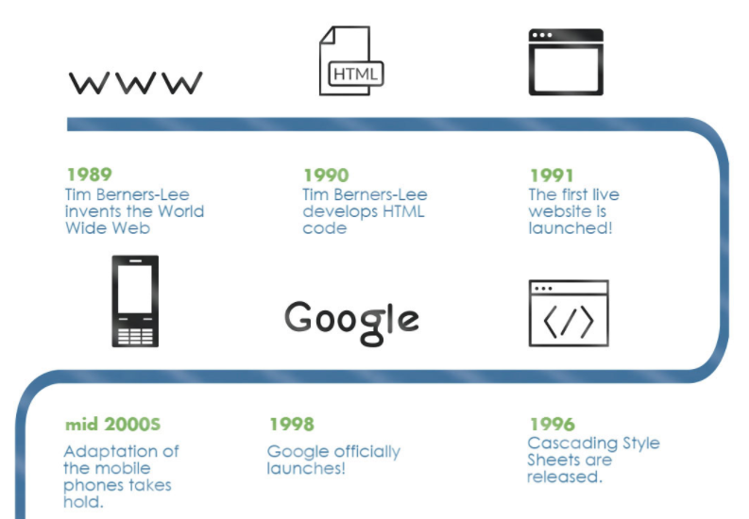
History of World Wide Web

Slide 7
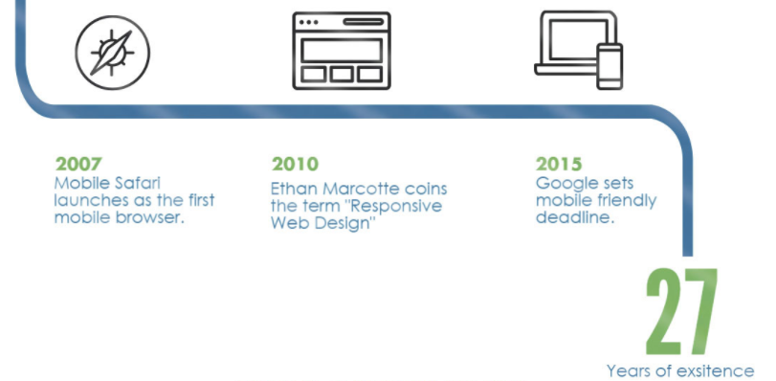
History of World Wide Web

Slide 8
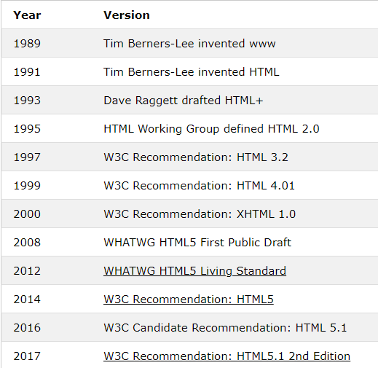
HTML History
Notes:
Since the early days of the World Wide Web, there have been many versions of HTML

Slide 9
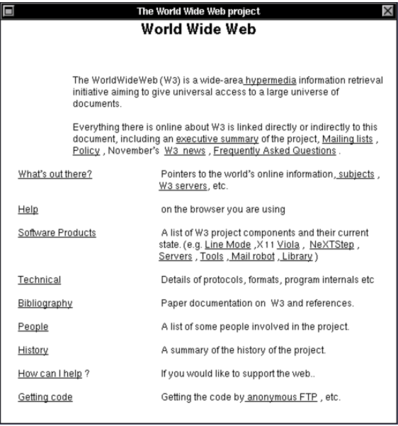
First Static Web Sites
The first web sites on the World Wide Web were writing in very basic mark up using HTML 1.
Navigating a web page on the initial version of NXT machine first browser was a very static experience compared to rich user experience we have today. Navigate the web using the first browser here: https://worldwideweb.cern.ch/
Notes:
https://www.spacejam.com/
https://interestingengineering.com/top-12-oldest-websites-from-the-80s-and-90s-still-online-today

Slide 10
What is HTML?

Slide 11


What is HTML?
HTML (Hypertext Markup Language) is not a programming language. It is a markup language that tells web browsers how to structure the web pages you visit. It can be as complicated or as simple as the web developer wants it to be. HTML consists of a series of elements, which you use to enclose, wrap, or mark up different parts of content to make it appear or act in a certain way. The enclosing tags can make content into a hyperlink to connect to another page, italicize words, and so on. For example, consider the following line of text:
If we wanted the text to stand by itself, we could specify that it is a paragraph by enclosing it in a paragraph (<p>) element:

Slide 12
HTML Tags
Note: Tags in HTML are case-insensitive. This means they can be written in uppercase or lowercase.
For example, a <title> tag could be written as <title>, <TITLE>, <Title>, <TiTlE>, etc., and it will work. However, it is best practice to write all tags in lowercase for consistency, readability, and other reasons.

Slide 13
HTML Recap
HTML stands for Hyper Text Markup Language
HTML is the standard markup language for creating Web pages
HTML describes the structure of a Web page
HTML consists of a series of elements
HTML elements tell the browser how to display the content
HTML elements label pieces of content such as "this is a heading", "this is a paragraph", "this is a link", etc.

Slide 14

Web Browsers
Websites run in browsers, which means you need some browsers to run websites!
Your users could be using any browser to visit the websites that you build for them. There are slight differences in the way that different browsers will render your websites, which means that you'll need to test your sites in all of them.
Now, you don't need to download every browser right now, but I want to make sure that you install the two most popular cross-platform browsers: Google Chrome and Mozilla Firefox.
Other browsers, like Apple Safari and Microsoft Edge, are fantastic as well and you should continue to browse and test your sites with them.

Slide 15
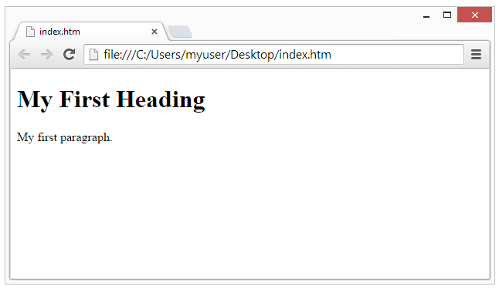
Web Browser cont..
The purpose of a web browser (Chrome, Edge, Firefox, Safari) is to read HTML documents and display them correctly.
A browser does not display the HTML tags, but uses them to determine how to display the document:

Slide 16
HTML Syntax

Slide 17
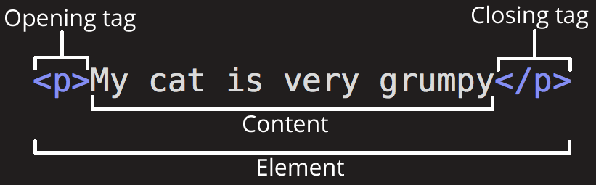
Atonomy of HTML Element
The opening tag: This consists of the name of the element (in this example, p for paragraph), wrapped in opening and closing angle brackets. This opening tag marks where the element begins or starts to take effect. In this example, it precedes the start of the paragraph text.
The content: This is the content of the element. In this example, it is the paragraph text.
The closing tag: This is the same as the opening tag, except that it includes a forward slash before the element name. This marks where the element ends. Failing to include a closing tag is a common beginner error that can produce peculiar results.
The element is the opening tag, followed by content, followed by the closing tag.

Slide 18
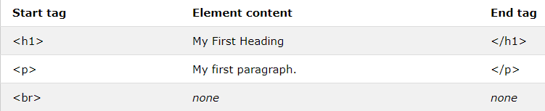
HTML Element Examples
Some HTML elements have no content (like the <br> element). These elements are called empty elements. Empty elements do not have an end tag!:

Slide 19
Nesting Elements
Elements can be placed within other elements. This is called nesting. If we wanted to state that our cat is very grumpy, we could wrap the word very in a <strong> element, which means that the word is to have strong(er) text formatting:
<p>My cat is <strong>very</strong> grumpy.</p>
There is a right and wrong way to do nesting. In the example above, we opened the p element first, then opened the strong element. For proper nesting, we should close the strong element first, before closing the p.
The following is an example of the wrong way to do nesting:
<p>My cat is <strong>very grumpy.</p></strong>
The tags have to open and close in a way that they are inside or outside one another. With the kind of overlap in the example above, the browser has to guess at your intent. This kind of guessing can result in unexpected results

Slide 20
Block vs Inline Elements
There are two important categories of elements to know in HTML: block-level elements and inline elements.
Block-level elements form a visible block on a page. A block-level element appears on a new line following the content that precedes it. Any content that follows a block-level element also appears on a new line. Block-level elements are usually structural elements on the page. For example, a block-level element might represent headings, paragraphs, lists, navigation menus, or footers. A block-level element wouldn't be nested inside an inline element, but it might be nested inside another block-level element.
Inline elements are contained within block-level elements, and surround only small parts of the document’s content. (not entire paragraphs or groupings of content) An inline element will not cause a new line to appear in the document. It is typically used with text. For example, as an <a> element (hyperlink) or emphasis elements such as <em> or <strong>.

Slide 21
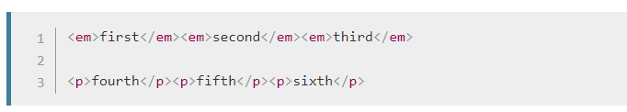
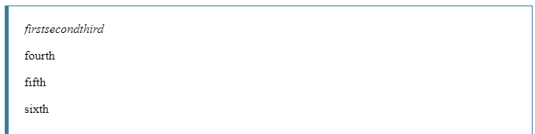
Block vs Inline Elements cont..
<em> is an inline element. As you see below, the first three elements sit on the same line, with no space in between. On the other hand, <p> is a block-level element. Each p element appears on a new line, with space above and below. (The spacing is due to default CSS styling that the browser applies to paragraphs.)

Slide 22
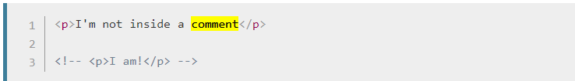
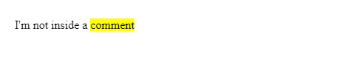
HTML Comments
HTML has a mechanism to write comments in the code. Browsers ignore comments, effectively making comments invisible to the user. The purpose of comments is to allow you to include notes in the code to explain your logic or coding. This is very useful if you return to a code base after being away for long enough that you don't completely remember it. Likewise, comments are invaluable as different people are making changes and updates.
To write an HTML comment, wrap it in the special markers <!-- and -->. For example:

Slide 23

Empty Elements
Not all elements follow the pattern of an opening tag, content, and a closing tag. Some elements consist of a single tag, which is typically used to insert/embed something in the document. For example, the <img> element embeds an image file onto a page:
The following output would be

Slide 24
HTML Structure

Slide 25
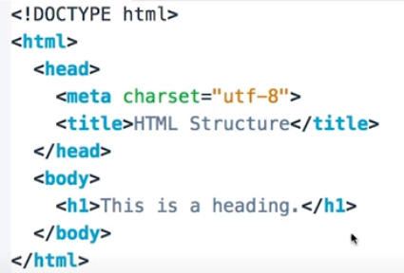
What is HTML Structure?
The <!DOCTYPE html> declaration defines that this document is an HTML5 document
The <html> element is the root element of an HTML page
The <head> element contains meta information about the HTML page
The <title> element specifies a title for the HTML page (which is shown in the browser's title bar or in the page's tab)
The <body> element defines the document's body, and is a container for all the visible contents, such as headings, paragraphs, images, hyperlinks, tables, lists, etc.
The <h1> element defines a large heading

Slide 26

HTML Structure Example

Slide 27
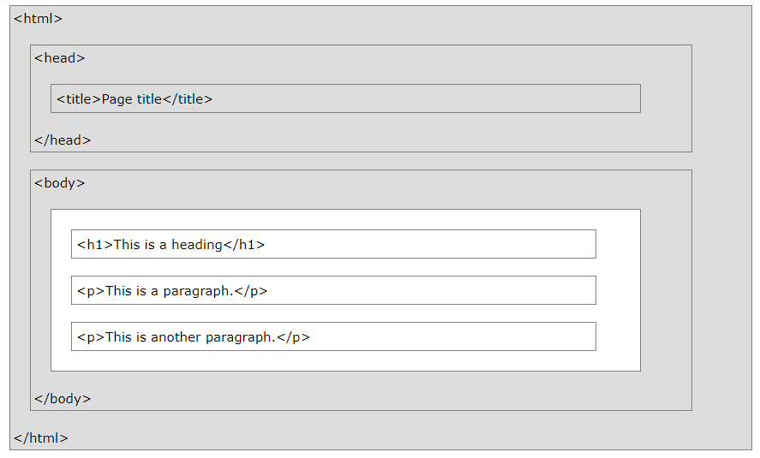
HTML Page Structure
Notes:
Only the content inside the <body> section (the white area above) will be displayed in a browser.

Slide 28
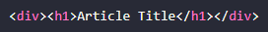
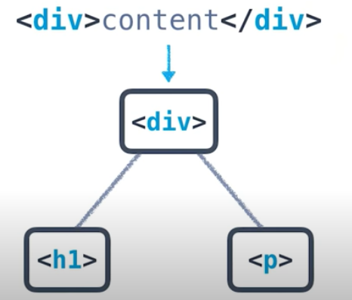
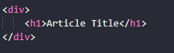
HTML and Trees
Elements can go inside other elements.
Content isn't just text, it is also other HTML elements
Division elements (<div></div>) are used to group chunks of content together
In the example, <h1> is the child element of the <div> element
We can reorganize this, so it is the structure is more clear
Notes:
<h1> is in it’s own row, so it is clear that <div> is the parent element in the tree.

Slide 29
HTML Document
An HTML Document can be thought of as a Template. This template can be broken down into 3 parts:
DOCTYPE: Describes the type of HTML. While there are technically different types, for 99.999% of the HTML you'll write, you’ll likely be fine with <!DOCTYPE html>.
<head>: Describes meta information about the site, such as the title, and provides links to scripts and stylesheets the site needs to render and behave correctly.
<body>: Describes the actual content of the site that users will see.
Notes:
<h1> is in it’s own row, so it is clear that <div> is the parent element in the tree.

Slide 30
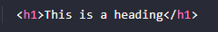
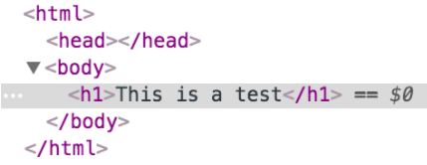
HTML Document
Omitting some of this information doesn't necessarily mean that the page won't be displayed. In fact, your browser will assume certain parts of the template exist even if you accidentally leave them out. Take this line of HTML for example:
If you create an HTML file with only this line, open the file in any modern browser, and inspect the page with developer tools, you’ll see that certain parts of the basic HTML document format were assumed:
Notes:
<h1> is in it’s own row, so it is clear that <div> is the parent element in the tree.

Slide 31
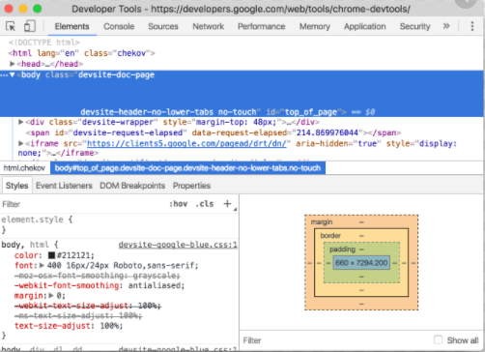
CHROME DEVELOPER TOOLS
Notes:
<h1> is in it’s own row, so it is clear that <div> is the parent element in the tree.

Slide 32
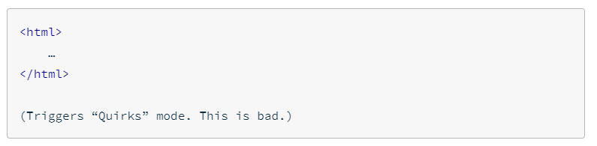
HTML Doctypes
HTML Doctypes
An HTML document will usually start with a type declaration (which is not a tag, so it should not have a closing tag). The declaration helps the browser determine what type of HTML document it’s trying to parse and display.
If you’ve ever looked at an older website using dev tools, you might have noticed a doctype that looks like this:
Or maybe you don’t see a doctype at all.

Slide 33
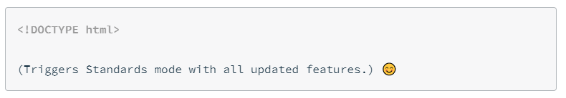
HTML Doctypes cont..
But newer websites (and your websites!) will have a declaration that looks like this:
Browsers look for this doctype declaration to determine which rendering mode to use to render the site. Generally, newer sites follow standard HTML specifications. The current standard HTML specification is called HTML5 (which is what you're learning!). On the other hand, older sites, created before HTML standards really existed, might use a different rendering mode that imitates the behavior of older browsers.
Once you’ve declared the doctype, the next part of your HTML document is the <html> tag, which tells the browser that everything enclosed inside the <html> ... </html> should be parsed as HTML. Then you have the two main sections of your HTML document: <head> and <body>

Slide 34
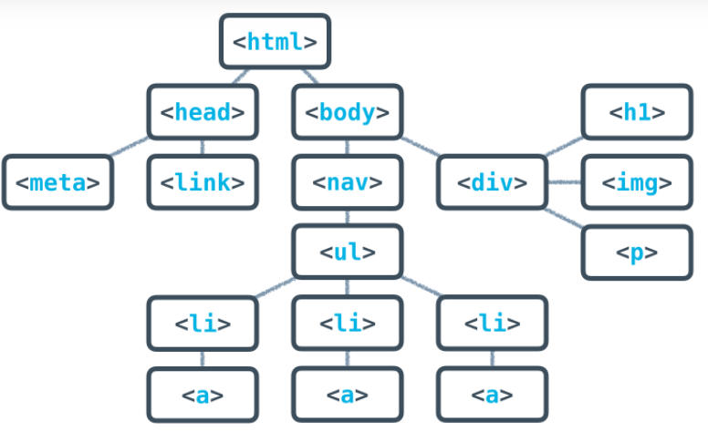
Full HTML Tree Structure
Notes:
<head> and <body>
The <head> will contain general information and metadata about the page, while the <body> will contain the content that will be displayed on the page. Here’s an example tree structure for a full HTML document:

Slide 35
HTML Documents In Depth
All of the HTML syntax that you’ve learned in this lesson will help you create the content of the page, which is always contained inside the <body> tags. The <body> is always visible.
The <head>, on the other hand, is never visible, but the information in it describes the page and links to other files the browser needs to render the website correctly. For instance, the <head> is responsible for:
the document’s title (the text that shows up in browser tabs): <title>About Me</title>.
associated CSS files (for style): <link rel="stylesheet" type="text/css" href="style.css">.
associated JavaScript files (multipurpose scripts to change rendering and behavior): <script src="animations.js"></script>.
the charset being used (the text's encoding): <meta charset="utf-8">.
keywords, authors, and descriptions (often useful for SEO): <meta name="description" content="This is what my website is all about!">.

Slide 36
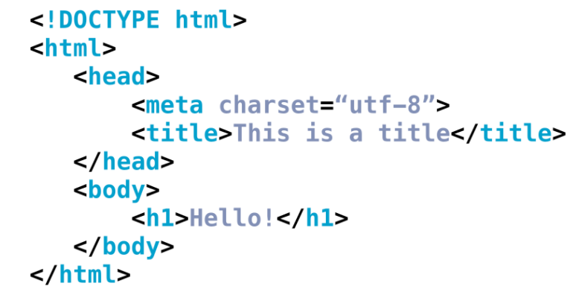
Header Tags : Meta and Title
<meta charset="utf-8"> is pretty standard, and will allow your website to display any Unicode character. (Read more on how UTF-8 works here.) <title> will define the title of the document and will be displayed in the tab of the browser window when a user visits the page.

Slide 37
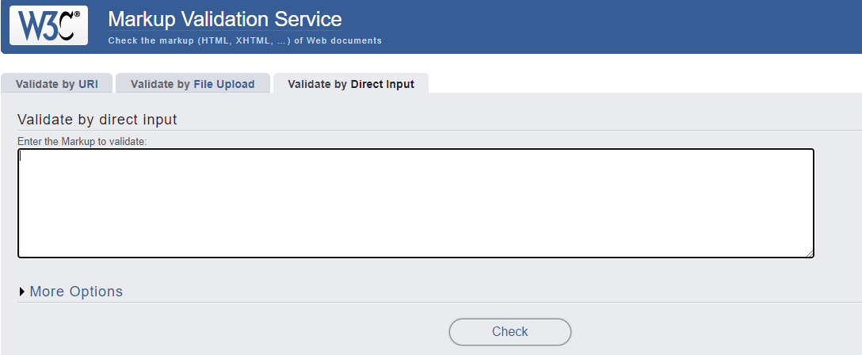
HTML Validators
This might seem like a lot to remember, but thankfully, there are tools out there to help you. Much like how the Udacity Feedback Extension tells you when you've met all the requirements for a particular project, HTML validators analyze your website and verify that you're writing valid HTML.
Notes:
https://validator.w3.org/#validate_by_input

Slide 38
QUIZ

Slide 39
Quiz 1
1. What is HTML?
a. An programming language
b. A Markup language
c. A database script
Notes:
https://validator.w3.org/#validate_by_input

Slide 40
Quiz 1
1. What is HTML?
a. An programming language
b. A Markup language
c. A database script
Notes:
https://validator.w3.org/#validate_by_input

Slide 41
Question 2
Will the browser interpret <HEAD> differently than <head> tag?
a. No, HTML is case-insensitve
b. Yes, HTML is not case-sensitive
Notes:
https://validator.w3.org/#validate_by_input

Slide 42
Question 2
Will the browser interpret <HEAD> differently than <head> tag?
a. No, HTML is case-insensitve
b. Yes, HTML is not case-sensitive
Notes:
https://validator.w3.org/#validate_by_input

Slide 43
Question 3
3. What is the atonomy HTML element consist of?
a. header tag, content tag, footer tag
b. doctype and meta data
c. open tag, content, closing tag
Notes:
https://validator.w3.org/#validate_by_input

Slide 44
Question 3
3. What is the atonomy HTML element consist of?
a. header tag, content tag, footer tag
b. doctype and meta data
c. open tag, content, closing tag
Notes:
https://validator.w3.org/#validate_by_input

Slide 45
Question 4
How do we construct comments in HTML?
a. /* This is a comment */
b. /// This is a comment
c. <!-- This is a comment -->
Notes:
https://validator.w3.org/#validate_by_input

Slide 46
Question 4
How do we construct comments in HTML?
a. /* This is a comment */
b. /// This is a comment
c. <!-- This is a comment -->
Notes:
https://validator.w3.org/#validate_by_input

Slide 47
Question 5
5. How can a HTML Page Structure be visualized?
a. A Linked Chain structure
b. A Flat structure
c. A Tree structure
Notes:
https://validator.w3.org/#validate_by_input

Slide 48
Question 5
5. How can a HTML Page Structure be visualized?
a. A Linked Chain structure
b. A Flat structure
c. A Tree structure
Notes:
https://validator.w3.org/#validate_by_input

Slide 49
Question 6
Why do we need a doctype declaration?
a. Browsers need it for the window name and title of window tab.
b. Browsers need it for unloading of web assets
c. Browsers need it to determine which rendering mode to render the site with.
Notes:
https://validator.w3.org/#validate_by_input

Slide 50
Question 6
Why do we need a doctype declaration?
a. Browsers need it for the window name and title of window tab.
b. Browsers need it for unloading of web assets
c. Browsers need it to determine which rendering mode to render the site with.
Notes:
https://validator.w3.org/#validate_by_input

